Slide 1
Sales Dataset Analysis
MEGANAHAN.A
23-06-2025
DA&DS RP-36

Slide 2
Project Overview & Objectives
Objective: Leverage data-driven insights to enhance sales strategies and operational efficiency. Identify growth opportunities, total revenue, and develop predictive sales models.
Goals:
Evaluate customer purchasing behavior and preferences.
Identify underperforming products and suggest improvement strategies.
Optimize discount strategies to maximize profitability.
Enhance reporting efficiency through automated Excel tools

Slide 3
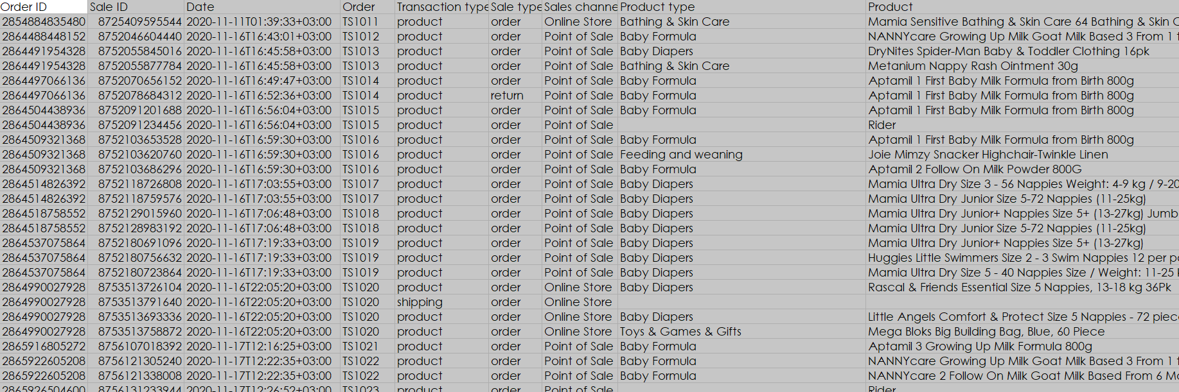
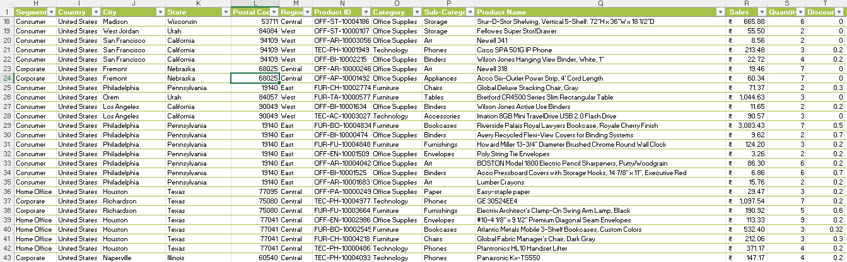
Data Description and Preparation
Removed duplicates & handled missing values.
Formatted data for better readability.
Used Power Query for transformation.

Slide 4
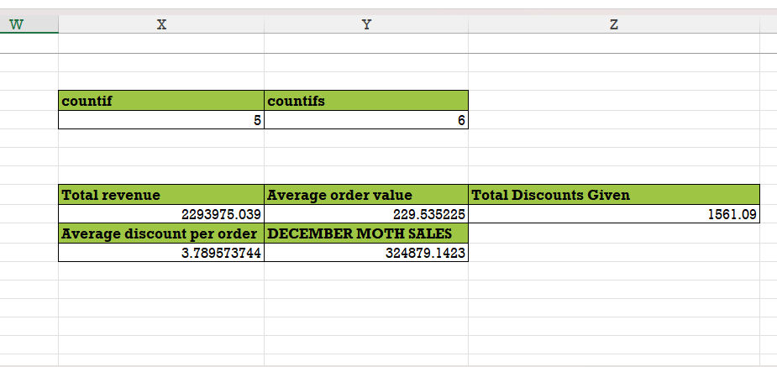

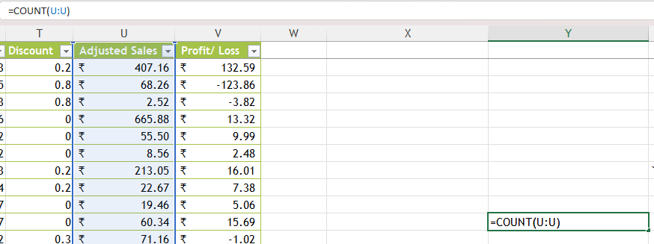
Key Metrics Calculation and Data Analysis
Total Sales Rs. 2293975.039
Total Discounts - 1561.09
Average Order Value 229.535225

Slide 5
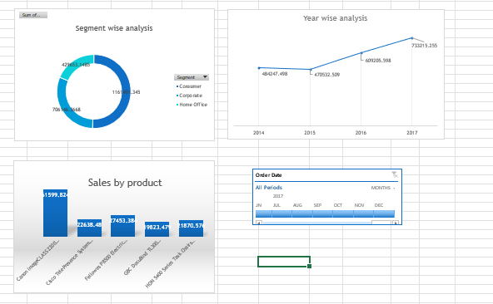
Pivot Tables and Pivot Charts
Created Pivot Tables for analysis
Used charts to visualize trends
compared sales by order , category & year
Made data easy to understand

Slide 6
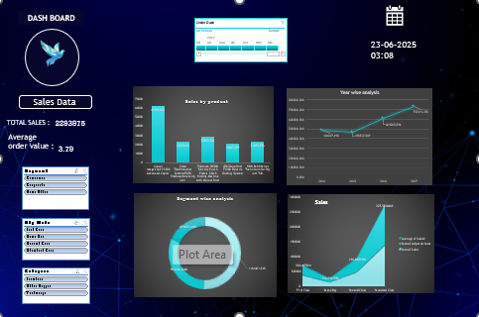
Dashboard Overview
Shows key performance metrics
Include Sales Per Year & Products
Interactive with slicers

Slide 7
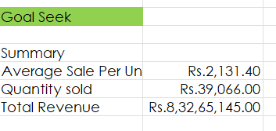
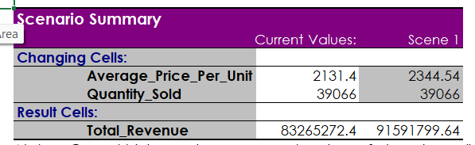
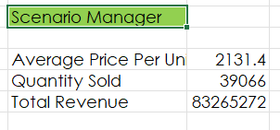
What-If Analysis & Goal Seek
Analyzed profit variations
Helped in business planning
Impact of a 10% price increase on revenue.

Slide 8
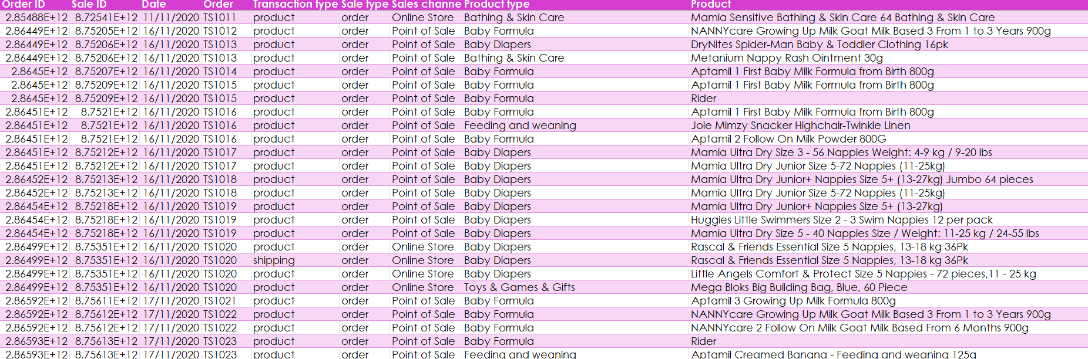
Macros and Automation
Automating data formatting & calculations.
Creating reports & updating charts
Saves time, reduces errors, and improves efficiency

Slide 9
Insights & Recommendations
home appliances are the top-selling product increase stock and promotional efforts.
Customers prefer organic products like office expand the organic product range
sales growth surpasses offline invest more in digital marketing and e-commerce platforms.

Slide 10
Conclusion & Questions
Sales Analysis: Aids decision-making by identifying trends and optimizing strategies.
Data Visualization: Simplifies reporting for quick and clear insights.
Predictive Analysis: Forecasts trends for future business growth.

Slide 11
THANK YOU

